Slide 1
Design Pattern
Instructor: Mehroze Khan

Slide 2
Introduction
Designing object-oriented software is hard, and designing reusable object-oriented software is even harder.
It takes a long time for novices to learn what good object-oriented design is all about. Experienced designers evidently know something inexperienced ones don't.
Expert designers find recurring patterns of classes and communicating objects in many object-oriented systems and can apply them immediately to design problems without having to rediscover them.
Each design pattern systematically names, explains, and evaluates an important and recurring design in object-oriented systems.
Recording experience in designing object-oriented software as design patterns.
Design patterns make it easier to reuse successful designs and architectures.

Slide 3
What is a Design Pattern?
Christopher Alexander says, "Each pattern describes a problem which occurs over and over again in our environment, and then describes the core of the solution to that problem, in such a way that you can use this solution a million times over, without ever doing it the same way twice".
In software engineering, a design pattern is a general repeatable solution to a commonly occurring problem in software design.
A design pattern isn't a finished design that can be transformed directly into code.
It is a description or template for how to solve a problem that can be used in many different situations.
You can’t just find a pattern and copy it into your program, the way you can with off-the-shelf functions or libraries.
The pattern is not a specific piece of code, but a general concept for solving a particular problem.
You can follow the pattern details and implement a solution that suits the realities of your own program.

Slide 4
What is a Design Pattern?
Four essential elements of a pattern::
The pattern name is a handle we can use to describe a design problem, its solutions, and consequences in a word or two.
The problem describes when to apply the pattern.
The solution describes the elements that make up the design, their relationships, responsibilities, and collaborations
The consequences are the results and trade-offs of applying the pattern.
The design patterns are descriptions of communicating objects and classes that are customized to solve a general design problem in a particular context.

Slide 5
Benefits
Design patterns offer several benefits in software development. Here are some of the key advantages:
1. Reusability:
- Design patterns provide tested, proven development paradigms. Developers can use these patterns to solve recurring problems without having to recreate solutions each time.
- Reusing design patterns helps in preventing subtle issues that can cause major problems and improves the overall software quality.
2. Maintainability:
- Design patterns make the code more maintainable. They provide a clear and modular structure, making it easier for developers to understand and modify existing code.
- When a specific part of the system needs to be changed, developers can focus on that particular part without affecting the entire codebase.
3. Scalability:
- Design patterns help in creating scalable solutions. They provide a foundation for building scalable and flexible software systems, making it easier to adapt to changing requirements and handle increased complexity.
4. Abstraction:
- Design patterns promote abstraction by providing a high-level view of the system. This allows developers to focus on essential details while hiding unnecessary complexities.
- Abstraction makes it easier to communicate and collaborate with other team members, as well as understand the overall architecture of the software.

Slide 6
Benefits
5. Encapsulation:
- Many design patterns promote encapsulation, which is the bundling of data and methods that operate on the data into a single unit or class. This helps in organizing code and prevents unintended interference from external components.
6. Flexibility:
- Design patterns make the code more flexible and adaptable to change. By following well-established patterns, developers can more easily incorporate new features or modify existing ones without disrupting the entire system.
7. Readability:
- Design patterns improve code readability. Since many developers are familiar with common design patterns, using them in code makes it easier for others to understand the structure and functionality of the software.
8. Collaboration:
- Design patterns provide a common vocabulary for developers. This facilitates communication and collaboration among team members, making it easier to discuss and share design ideas and solutions.
9. Performance Optimization:
- Some design patterns help in optimizing the performance of the software.
10. Proven Solutions:
- Design patterns encapsulate best practices and proven solutions to common problems. Leveraging these patterns can save development time and reduce the likelihood of introducing errors.

Slide 7
Drawbacks
While design patterns offer numerous benefits, it's important to be aware of potential drawbacks and considerations:
1. Complexity:
- Overusing design patterns can lead to overly complex and convoluted code. Not every problem requires a design pattern and applying them unnecessarily can make the code harder to understand and maintain.
2. Rigidity:
- Design patterns, if applied too rigidly, may make the system inflexible to change. In some cases, adhering strictly to a pattern may hinder the ability to adapt the software to evolving requirements.
3. Applicability:
- Not all design patterns are suitable for every situation. Choosing the wrong pattern for a particular problem can lead to unnecessary complexity and reduced code efficiency.
4. Overhead:
- Introducing design patterns can introduce additional layers of abstraction and indirection, which may result in some performance overhead. In performance-critical applications, this can be a concern.

Slide 8
Drawbacks
5. Anti-patterns:
- Misusing or misunderstanding design patterns can lead to the creation of anti-patterns—solutions that seem to solve a problem but introduce more issues. This can happen when a pattern is applied without a clear understanding of its intent.
6. Code Bloat:
- In some cases, design patterns may lead to code bloat, where the structure of the pattern adds more lines of code than a simpler, more direct solution would. This can impact readability and maintenance.
7. Lack of Creativity:
- Relying too heavily on design patterns might stifle creativity in problem-solving. Developers may become accustomed to applying known patterns without considering innovative or more efficient alternatives.

Slide 9
Design Patterns MVC
Model is the application object
View is the model's screen presentation
Controller defines the way the user interface reacts to user input.
MVC decouples views and models by establishing a subscribe/notify protocol between them.

Slide 10
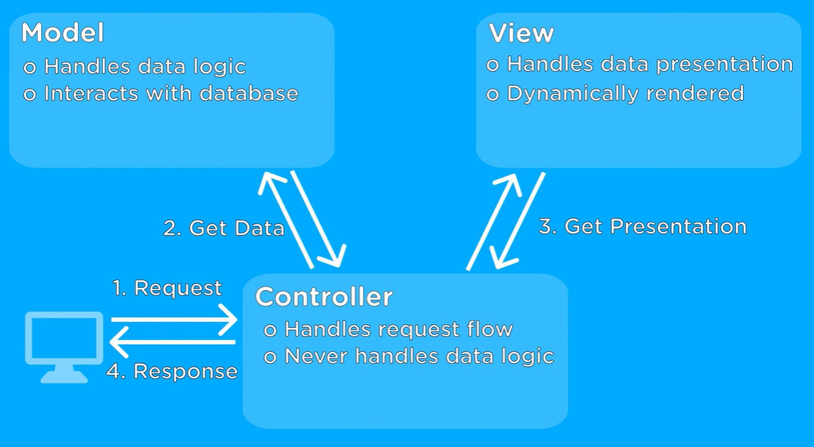
MVC (Model View Controller)

Slide 11
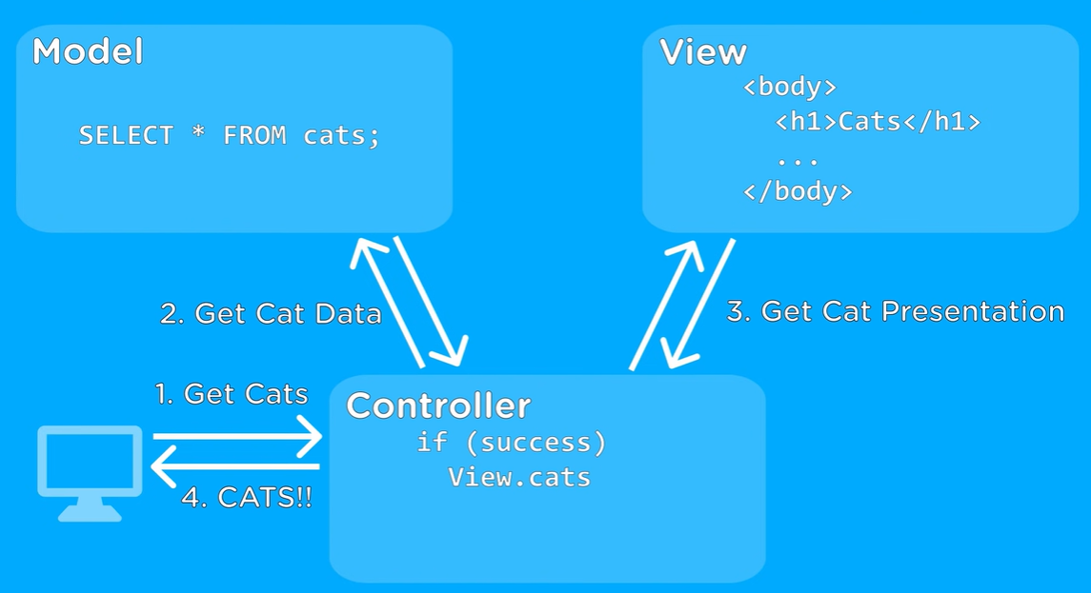
MVC (Model View Controller)

Slide 12
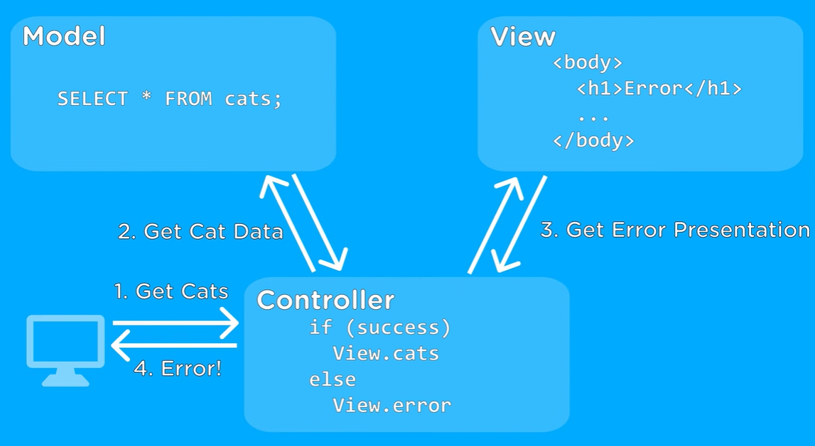
MVC (Model View Controller)

Slide 13
Describing Design Patterns
Pattern Name and Classification
Intent
What does the design pattern do? What is its rationale and intent? What particular design issue or problem does it address?
Also Known As (Other well-known names)
Motivation
A scenario that illustrates a design problem and how the class and object structures in the pattern solve the problem.
Applicability
What are the situations in which the design pattern can be applied?
Structure
A graphical representation of the classes in the pattern using a notation based on UML.
Participants
The classes and/or objects participating in the design pattern and their responsibilities.

Slide 14
Describing Design Patterns
Collaborations
How the participants collaborate to carry out their responsibilities.
Consequences
How does the pattern support its objectives? What are the trade-offs and results of using the pattern?
Implementation
What should you be aware of when implementing the pattern? Are there language-specific issues?
Sample Code
Code fragments that illustrate how you might implement the pattern in particular object-oriented programming languages.
Known Uses
Examples of the pattern found in real systems.
Related Patterns
What design patterns are closely related to this one? What are the important differences? With which other patterns should this one be used?

Slide 15
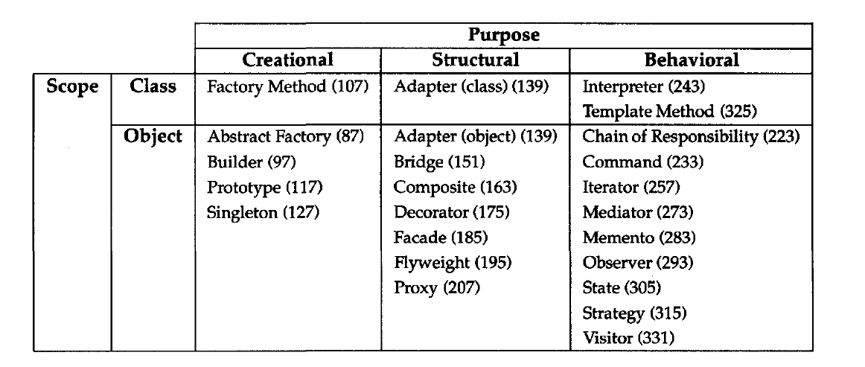
Catalog of Design Patterns

Slide 16
Purpose
The first criterion, called purpose, reflects what a pattern does.
Patterns can have either creational, structural, or behavioral purpose.
There are three main groups of patterns:
Creational patterns provide object creation mechanisms that increase flexibility and reuse of existing code.
Structural patterns explain how to assemble objects and classes into larger structures, while keeping these structures flexible and efficient.
Behavioral patterns take care of effective communication and the assignment of responsibilities between objects.

Slide 17
Scope
The second criterion, called scope, specifies whether the pattern applies primarily to classes or to objects.
Class patterns deal with relationships between classes and their subclasses. These relationships are established through inheritance, so they are static—fixed at compile-time.
Object patterns deal with object relationships, which can be changed at run-time and are more dynamic.

Slide 18
Reuse Mechanism
Inheritance versus Composition
The two most common techniques for reusing functionality in object-oriented systems are class inheritance and object composition.
Class Inheritence lets you define the implementation of one class in terms of another’s.
Reuse by subclassing is often referred to as white-box reuse.
The term "white-box" refers to visibility: With inheritance, the internals of parent classes are often visible to subclasses.
Object composition is an alternative to class inheritance.
New functionality is obtained by assembling or composing objects to get more complex functionality.
Object composition requires that the objects being composed have well-defined interfaces.
This style of reuse is called black-box reuse, because no internal details of objects are visible. Objects appear only as "black boxes."

Slide 19
Reuse Mechanism
Class inheritance
Advantages
Supported by programming languages, defined statically at compile-time and is straightforward to use.
Make it easier to modify the implementation being reused, when a subclass overrides some but not all operations.
Disadvantages
Cannot change the implementations/representations inherited from parent classes at run-time.
Implementation dependency between a subclass and its parent class.

Slide 20
Reuse Mechanism
Object composition
Advantages
Defined dynamically at run-time by referencing interfaces of objects.
Access other objects though their interfaces only, do not break encapsulation.
Fewer implementation dependencies.
Small class hierarchies
Disadvantages
Design based on object composition have more objects
The system's behavior will depend on their interrelationships instead of being defined in one class
One of the principle of object-oriented design: Favor object composition over class inheritance.

Slide 21
How to select a Design Pattern
Consider how design patterns solve design problems.
Scan Intent sections.
Study how patterns interrelate.
Study patterns of like purpose.
Examine a cause of redesign.
Consider what should be variable in your design.

Slide 22
Reference
Design Patterns: Elements of Reusable Object-Oriented Software, Erich Gamma, Richard Helm, Ralph Johnson, and John Vlissides, Pearson, 1995.

